Slide 1
Real-time Convolutional NN for Emotion Classification
Team 11
Qintian Huang
Zhiqi Chen
Zhangde Song
REFERENCES:
[1] Zhang J., Bargal S. A., Lin Z., Brandt J., Shen X., & Sclaroff S. (2018). Top-down neural attention by excitation backprop – International Journal of Computer Vision, 126(10), 1084-1102.
[2] Bargal S. A.*, Zunino A.*, Kim D., Zhang J., Murino V. and Sclaroff S. (2018). Excitation Backprop for RNNs – Proc. IEEE Conf. on Computer Vision and Pattern Recognition (CVPR).
[3] Zunino A.*, Bargal S. A.*, Morerio P., Zhang J., Sclaroff S., & Murino V. (2018). Excitation Dropout: Encouraging Plasticity in Deep Neural Networks – arXiv preprint arXiv:1805.09092.

Slide 2
Motivation
1. Interpreting Emotion is Complicated
High Variance Of the Sample (Races, Age, Individual differences)->
Millions of Parameter and thousands of samples
2. Human Accuracy of Emotion Classification on 7 different emotion is about 70% (Fer-2013)
CNN Emotion Classification Problems
3. Require Millions of Parameter ->
Deployment on Real-time System - Unfeasible
4. DataSet Bias ->
Ex: Western Facial Features, Glass Wearing

Slide 3
Goal
Propose an implementation on a general CNN building framework for designing real time emotion classification problem
Reduce the slow performance and deploy a real time architecture
Investigate on this model.

Slide 4
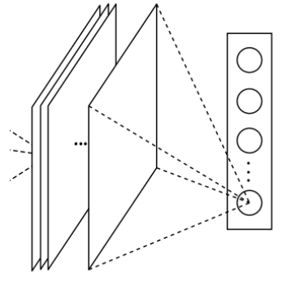
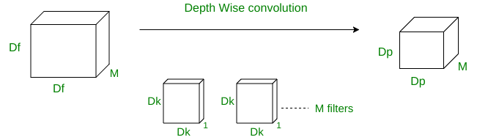
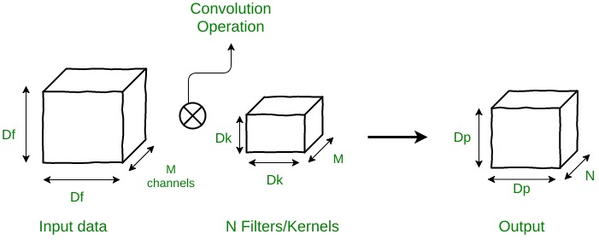
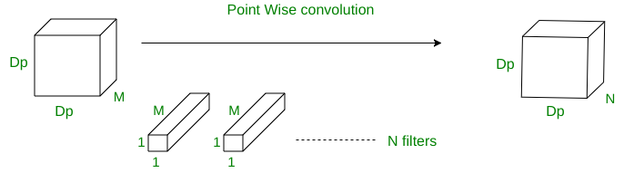
Main Reference Work:)
Real Time CNN Emotion and Gender Classification
VGG16 (CNN with Dense Layers)
90% of it parameters are in the last fully connected layers
Inception V3 (Global Average Pooling)
designed to replace fully connected layers in classical CNNs
take the average of each feature map, and the resulting vector is fed directly into the softmax layer.
generate one feature map for each corresponding category of the classification task in the last layer
Xecption (Residual Module & Depth-wise Convolution)
Standard: N x Dp2 x Dk2 x M
Depth wise separable: M x Dp2 x (Dk2 + N) [Depth wise conv. multiplications + Point wise conv. multiplications]
DataSet: Fer - 2013
approximately 30,000 facial RGB images -- size 48×48 -- labels 0=Angry, 1=Disgust, 2=Fear,
3=Happy, 4=Sad, 5=Surprise, 6=Neutral.

Slide 5
Goal of this architecture:
Reduce the number of parameters
Why?
the use of small CNNs alleviate us from slow performances in hardware-constrained systems
the reduction of parameters provides a better generalization

Slide 6
Two models:
sequential fully-CNN: eliminating completely the fully connected layers
mini-Xception: combines the deletion of the fully connected layer and the inclusion of the combined depth-wise separable convolutions and residual modules

Slide 7
sequential fully-CNN
used Global Average Pooling to completely remove any fully connected layers
achieved by having in the last convolutional layer the same number of feature maps as number of classes, and applying a softmax activation function to each reduced feature map
is a standard fully-convolutional neural network composed of 9 convolution layers, ReLUs, Batch Normalization and Global Average Pooling
Notes:
The 1st model: sequential fully-CNN
- used Global Average Pooling to completely remove any fully connected layers ->
- achieved by having in the last convolutional layer the same number of feature maps as number of classes, and applying a softmax activation function to each reduced feature map
- is a standard fully-convolutional neural network composed of 9 convolution layers, ReLUs, Batch Normalization and Global Average Pooling

Slide 8
mini-Xception
inspired by the Xception architecture
combines the use of residual modules and depth-wise separable convolutions

Slide 9
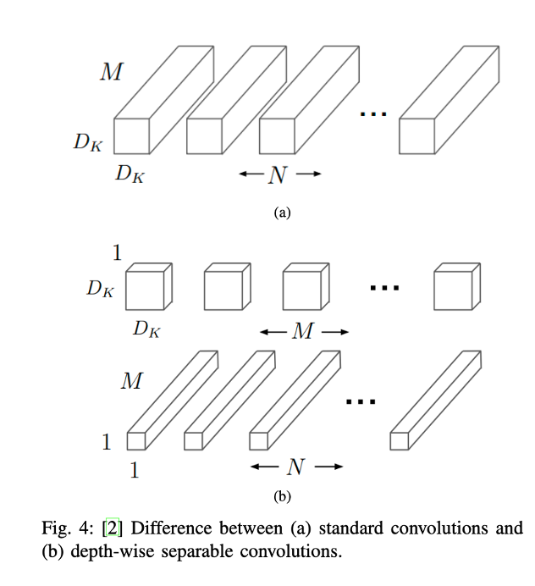
depth-wise separable convolutions
to eliminate parameters from the convolutional layers
composed of two different layers: depth-wise convolutions and point-wise convolutions ->
to separate the spatial cross-correlations from the channel cross-correlations
Notes:
- depth-wise separable convolutions: eliminating parameters from the convolutional layers
- depth-wise separable convolutions composed of two different layers: depth-wise convolutions and point-wise convolutions -> The main purpose of these layers is to separate the spatial cross-correlations from the channel cross-correlations -> do this by first applying a D × D filter on every M input channels and then applying N 1 × 1 × M convolution filters to combine the M input channels into N output channels -> Applying 1 × 1 × M convolutions combines each value in the feature map without considering their spatial relation within the channel

Slide 10
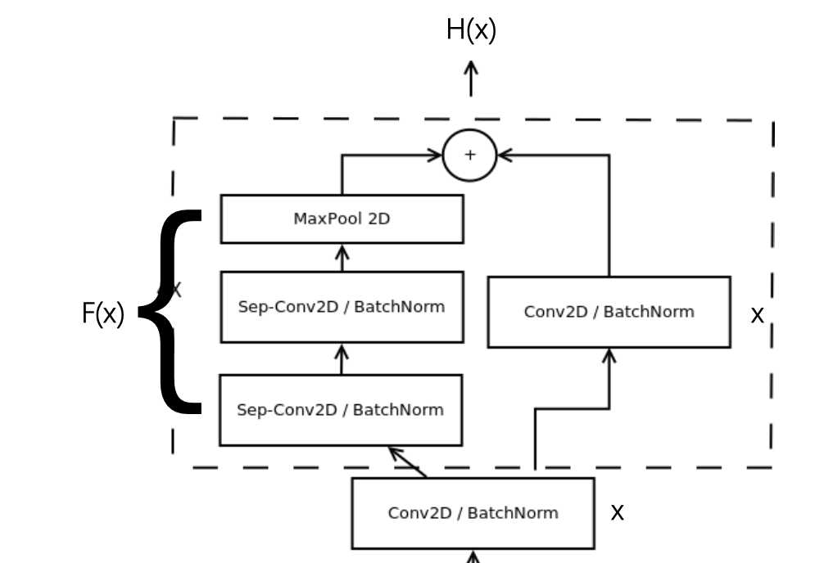
residual modules
modify the desired mapping between two subsequent layers, so that the learned features become the difference of the original feature map and the desired features
Consequently, the desired features H(x) are modified in order to solve an easier learning problem F(X) such that: H(x) = F(x) + x

Slide 11
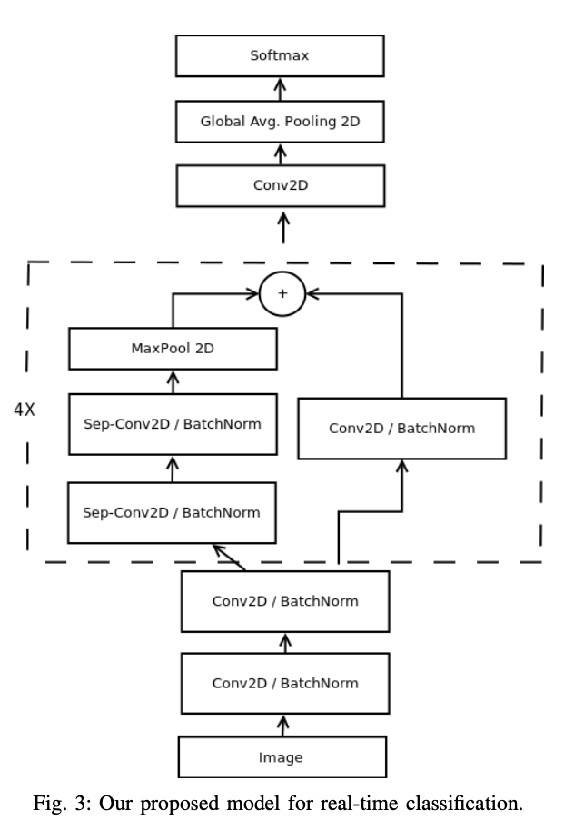
mini-Xception
inspired by the Xception architecture
combines the use of residual modules and depth-wise separable convolutions
is a fully-convolutional neural network that contains 4 residual depth-wise separable convolutions where each convolution is followed by a batch normalization operation and a ReLU activation function. The last layer applies a global average pooling and a soft-max activation function to produce a prediction

Slide 12
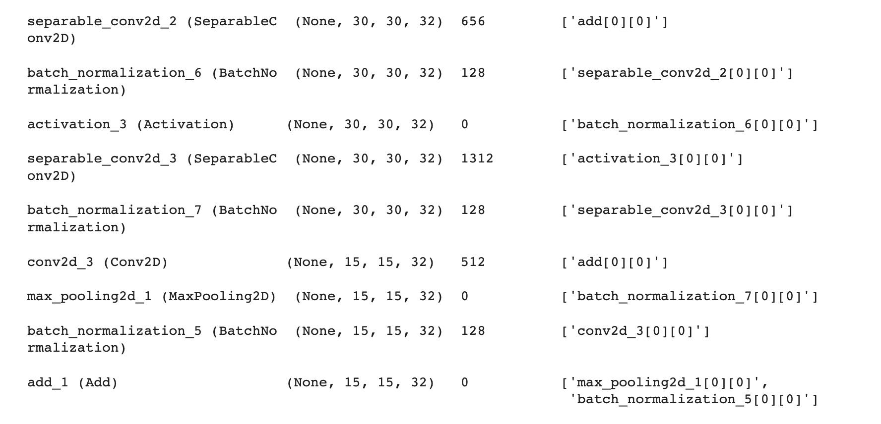
Investigation
Reproduce the results of the paper
Can we decrease the number of parameters to decrease execution time?
Investigated on number of residual modules

Slide 13
Method
Implement mini_XCeption with varied number of residual modules
We investigated:
model performance on accuracy
confusion matrix
training history of accuracy & loss
application

Slide 14
Experimental Setup
Dataset: FER2013
consists 35,685 examples of 48x48 pixel grayscale images of faces
seven categories (0=Angry, 1=Disgust, 2=Fear, 3=Happy, 4=Sad, 5=Surprise, 6=Neutral)
Network: mini_XCeption
proposed by the referenced literature

Slide 15
Training Details
Training strategies
Early stop
save checkpoint and stop when detects overfitting
data augmentation
ImageGenerator, which does:
random crop
random rotation
saturation
brightness
contrast
flip
transform
cross validation
split data into train data and validation data

Slide 16
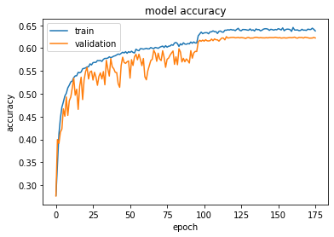
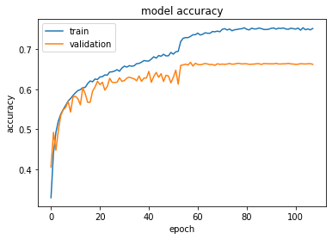
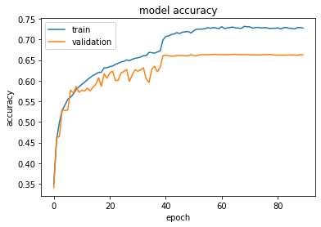
Experiment Results - Accuracy
3 Residual Modules
Final Accuracy: 0.53
Original (4 modules)
5 Residual Modules
Final Accuracy: 0.66
Same as the model proposed by the paper

Slide 17
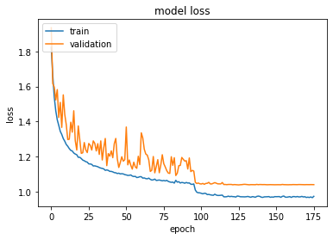
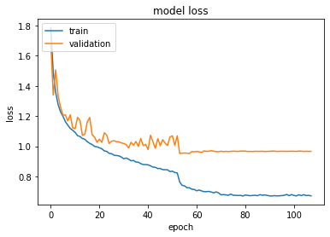
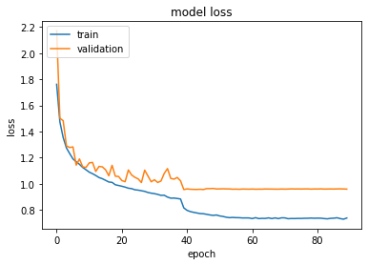
Experiment Results - Loss
3 Residual Modules
Original (4 modules)
5 Residual Modules

Slide 18
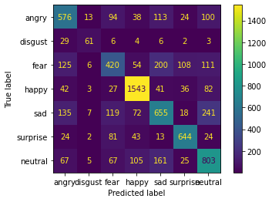
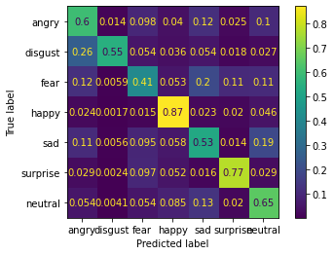


Confusion Matrix
Actual Number
Normalized
Using existing model provided by the author
Re train the model using same architecture
(4 modules)

Slide 19
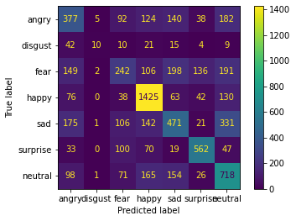
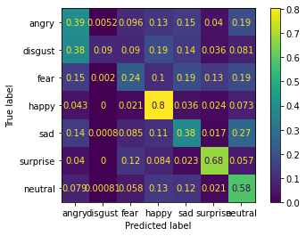
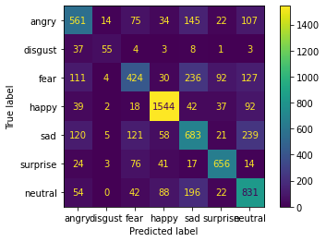
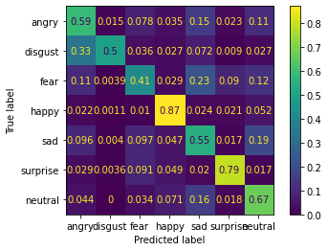
Confusion Matrix
Actual Number
Normalized
3 modules
5 modules

Slide 20
Module Load time & Execution time
Averaged with 25 runs for each model
Original : Ave Time: 0.0700
Module_2 : Ave Time: 0.0510
Module_3 : Ave Time: 0.0526
Module_4 : Ave Time: 0.0514
Module_5 : Ave Time: 0.0430

Slide 21
Investigation Conclusion
The highest accuracy with using residual modules is 66%, which is near human performance
Less residual modules will lead to significant lower performance, but not significant decrease in execution time

Slide 22

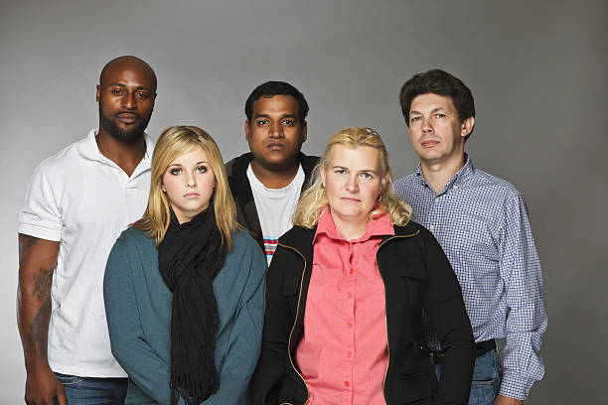

Demos
Models used for image emotion classification:
Gender
Emotion
Face Detection

Slide 23
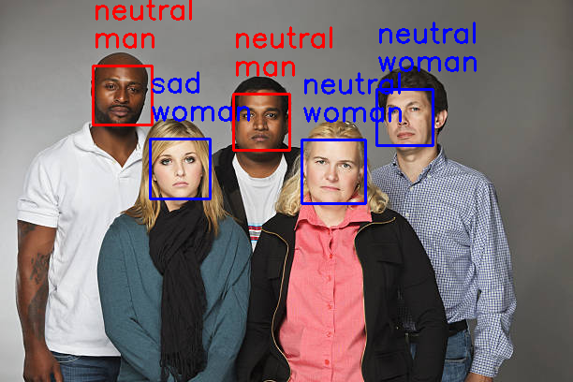
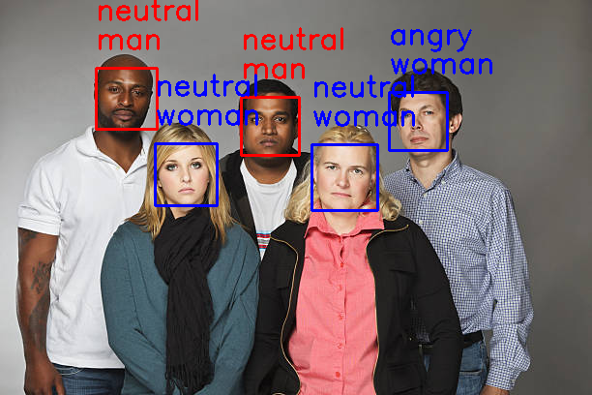

Demos
Original
3 modules
4 modules
5 modules

Slide 24
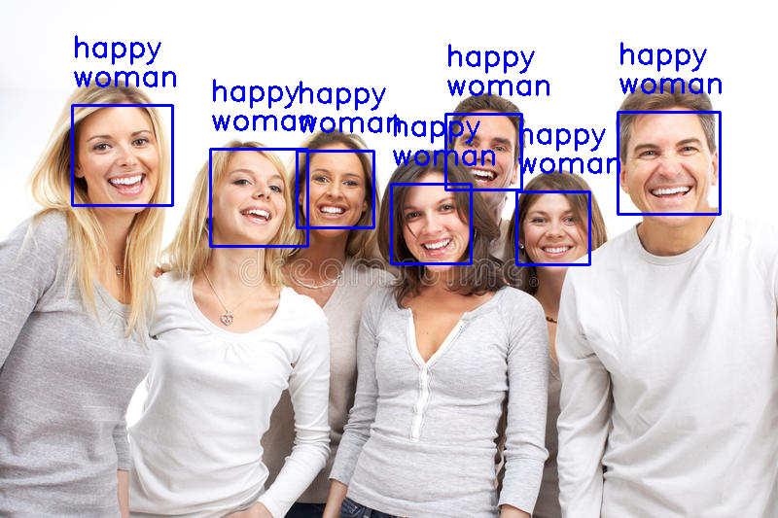
Demos
Original
3 modules
4 modules
5 modules

Slide 25
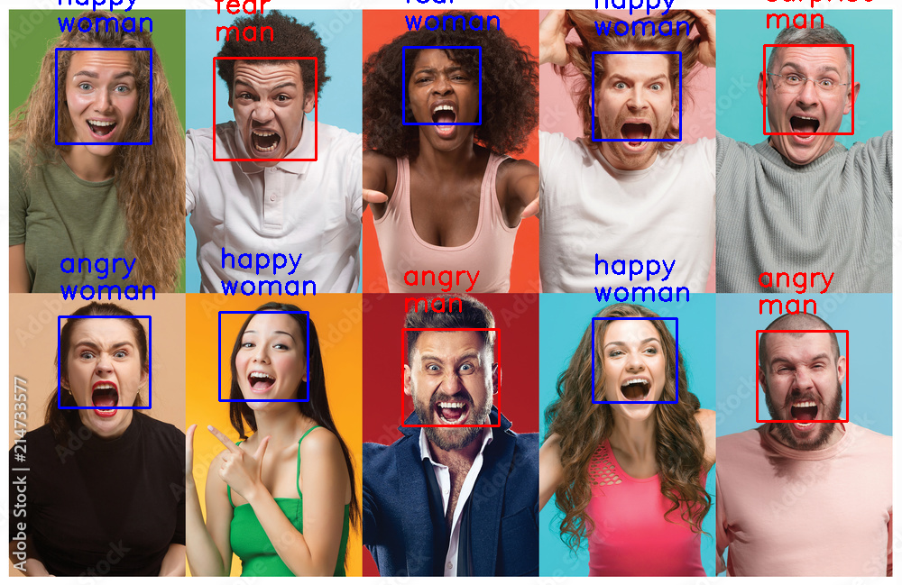
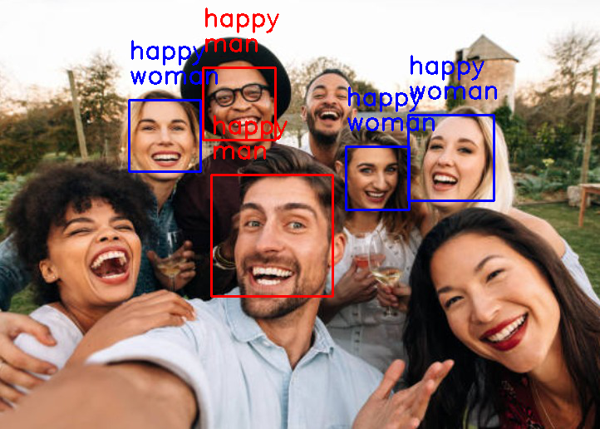
Demos

Slide 26
QUESTIONS?
GitHub Link: https://github.com/qthuang/cs523_sum2022.git
Thank you!

